Slide 1
Social Capital Conference
July 23, 2011
#socapott
Earning dividends on your blogging investment
Andrea Tomkins @missfish
Shannon McKarney @zchamu
Rebecca Stanisic @bitofmomsense

Slide 2
Links and Resources
Monetizing the Big Three
Ad Networks:
Federated Media www.federatedmedia.net
Google AdSense
Blogher: www.blogher.com
Affiliate networks:
Commission Junction www.cj.com
ShareASale: www.shareasale.com
Private affiliate programs (individual businesses may run their own)
Resources:
Problogger: http://www.problogger.net/archives/category/affiliate-programs/
Problogger the Book

Slide 3
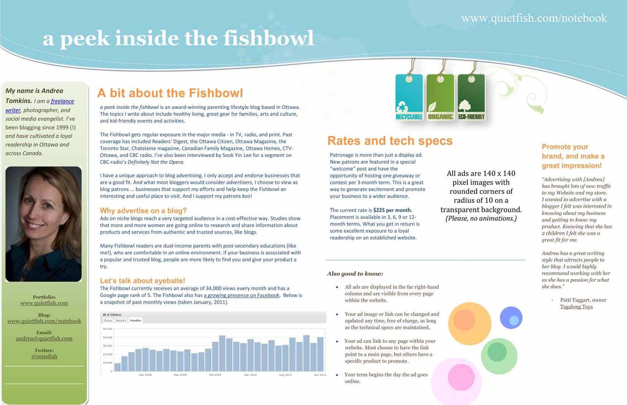
Links and Resources
Rate Card Example

Slide 4
Links and Resources
I didn’t know I could do that!
Sources for potential paid articles/writing/blogging/SM jobs
Mom Central Grants: www.momcentralcanada.com
Problogger paid writing resources: http://jobs.problogger.net
EverythingMom article requests: www.everythingmom.com
Clever Girls Collective: www.clevergirlscollective.com
Resources:
Article: What is an Online Community Manager? http://michaelfraietta.com/2010/12/what-is-an-online-community-manager/

Slide 5
Links and Resources
Is there $ in 0
Guest blogging websites/Article submission
Yummy Mummy Club www.yummymummyclub.ca
Magazines
Keep an eye on other SM resources (Faceboook, Twitter)
Resources:
Looking at why Free isn’t always the best: http://www.chrisbrogan.com/the-audacity-of-free/
10 Proven Steps to Snag a guest post on an A list blog: http://www.copyblogger.com/guest-posts/

Slide 6
Links and Resources
The Business of You: Pay your bills
Freshbooks www.freshbooks.com
Wave Accounting www.waveaccounting.com
PayPal: www.paypal.com
Klout.com
Alexa.com
Twitter chats: #blogchat, #savvyblogging, #momeochat
Google Analytics

Slide 7
Social Capital Conference
July 23, 2011
Earning dividends on your blogging investment
Andrea Tomkins @missfish
Shannon McKarney @zchamu
Rebecca Stanisic @bitofmomsense

